Slide 1
BCIT Lost & Found
Team 2 - Minsu, Hyelim, Hailey
Notes:
2

Slide 2
Agenda
Problem
Key Features
Live Demo & Code
1
3
5
2
4
6
Solution & Benefits
System Architecture
Conclusion

Slide 3
Problem
1

Slide 4
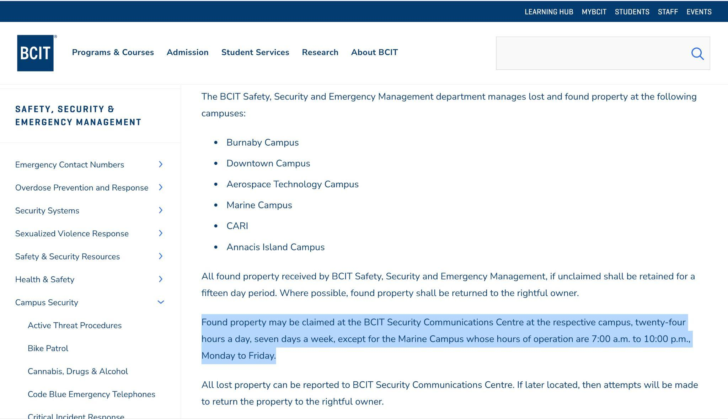

Slide 5
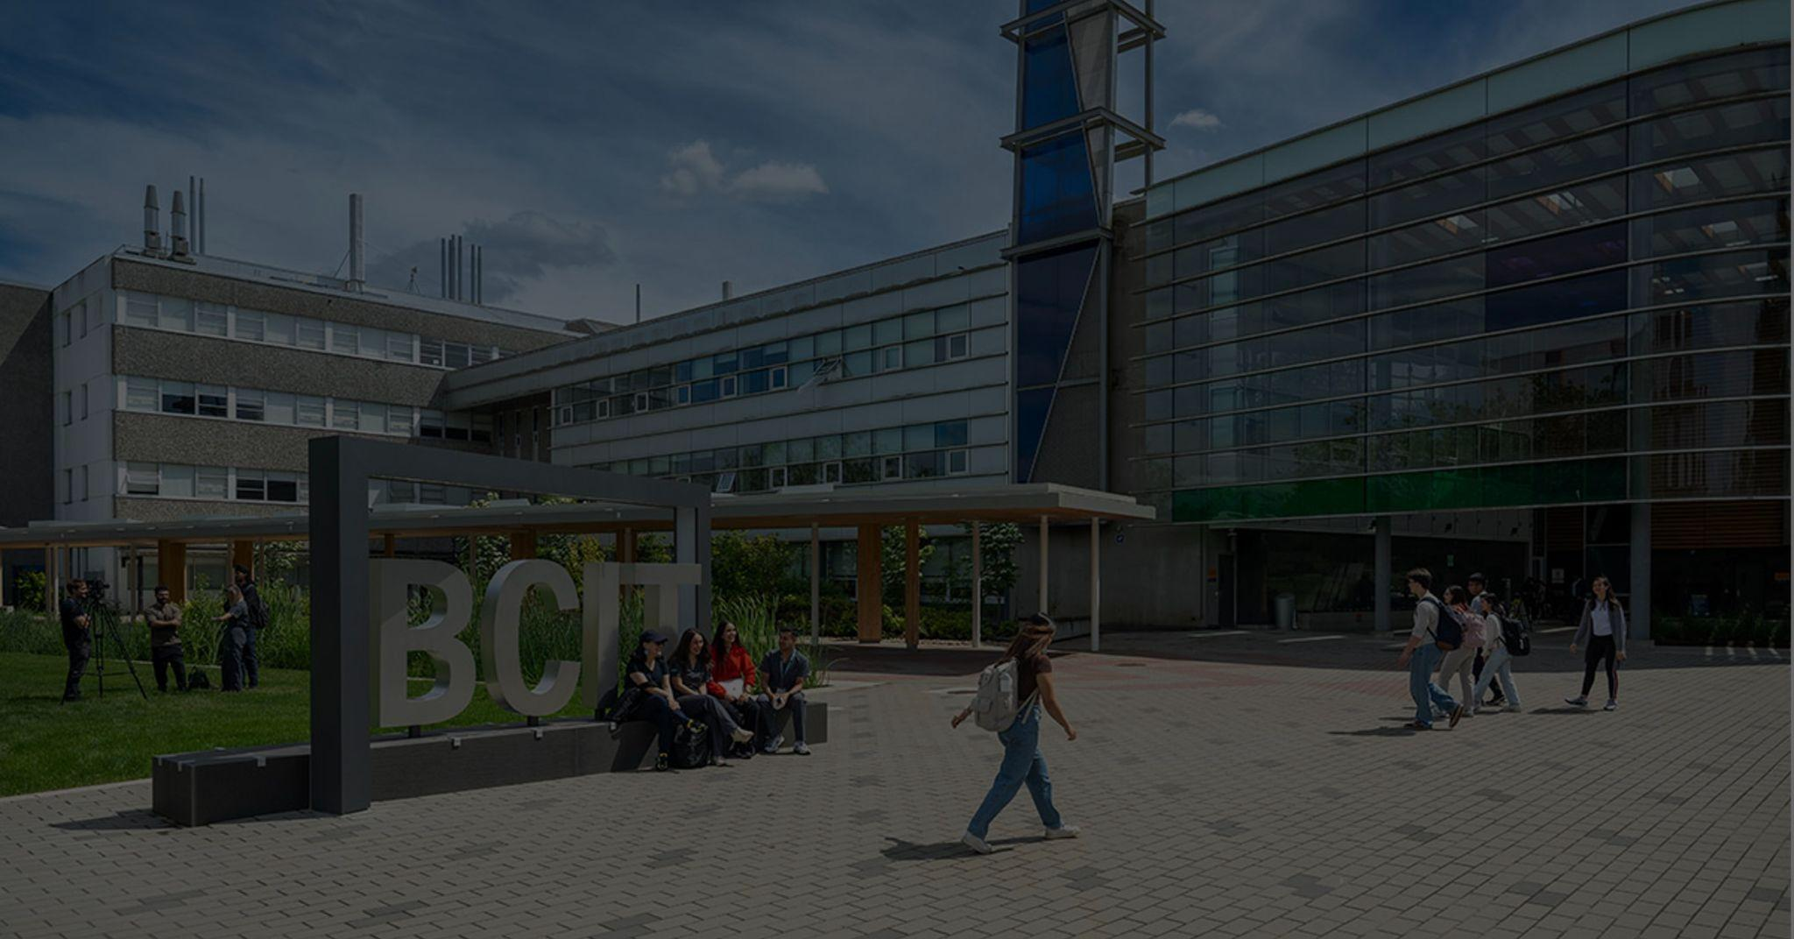
15-Day Limit
According to BCIT policy, unclaimed items are either disposed of or donated after only 15 days
Manual Search
Students must physically visit or call security offices across different campuses to locate their lost items
Inefficient System
The current analog method is slow and outdated to help students recover items within this short "golden time"

Slide 6
Solution & Benefits
2

Slide 7
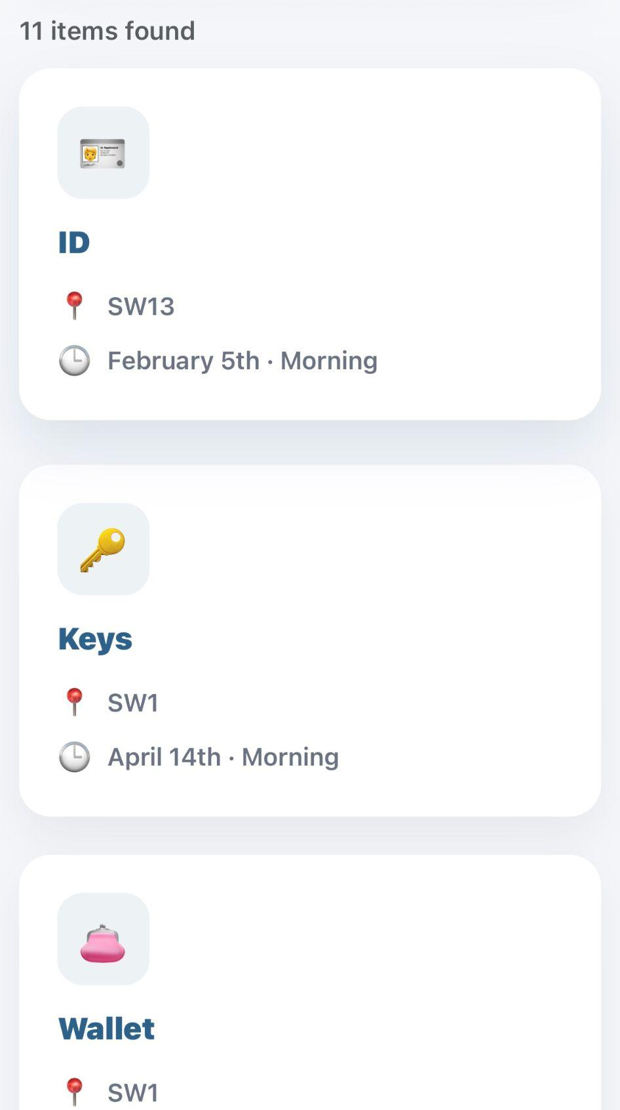
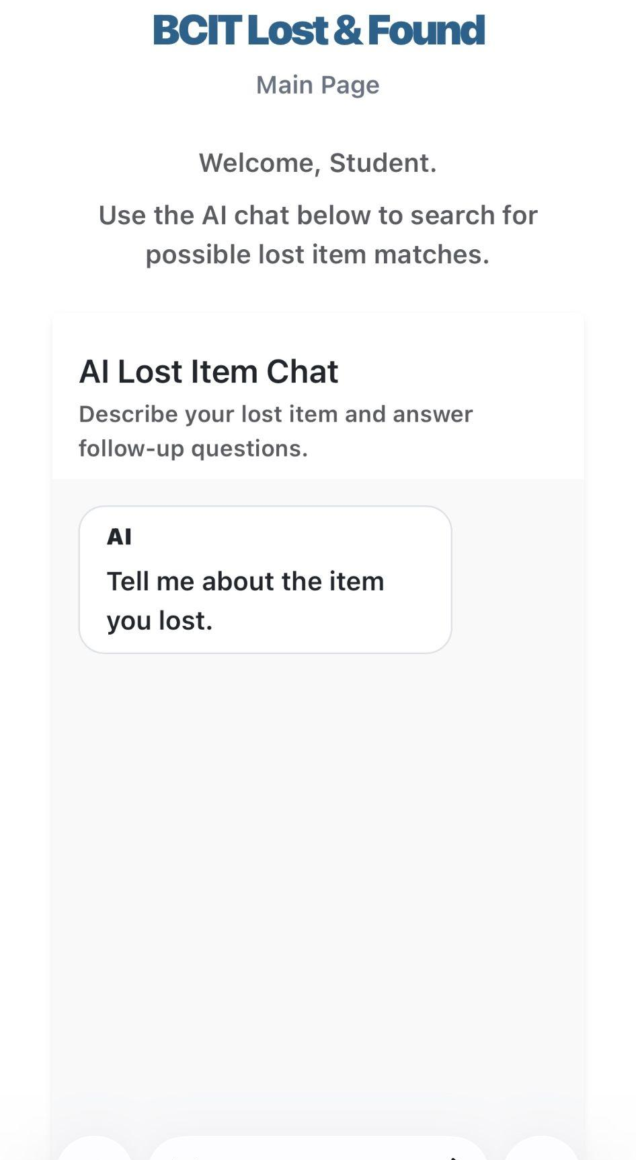
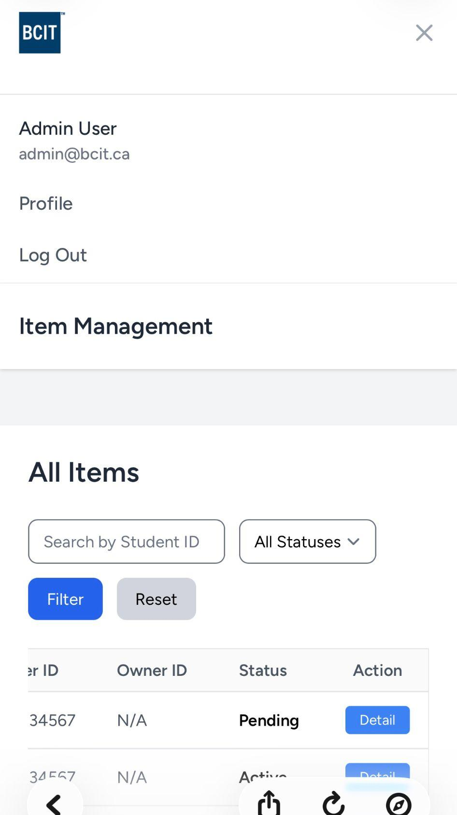
Digital Lost & Found Board
A web application that connects all buildings on the Burnaby campus
Effortless Discovery via AI Chat
Simply describe what you lost in natural language
Status Management System
Backend logic that handles the entire lifecycle (Pending → Active → Claimed).

Slide 8
Solution & Benefits
Time-Saving : Reduces the time spent searching for lost items
Centralized Data : Centralizes all lost and found information in one place
Quick Registration : Enables quick item registration for finders
Clear Process : Provides a clear process for claiming and returning items
Smart Search : Helps users find items even with incomplete information

Slide 9
Key Features
3

Slide 10
Key Features
Users can register found items
Admin reviews items and updates status
Only approved items are visible to users
Users can request a claim
Admin confirms item return and updates status

Slide 11
System Architecture
4

Slide 12
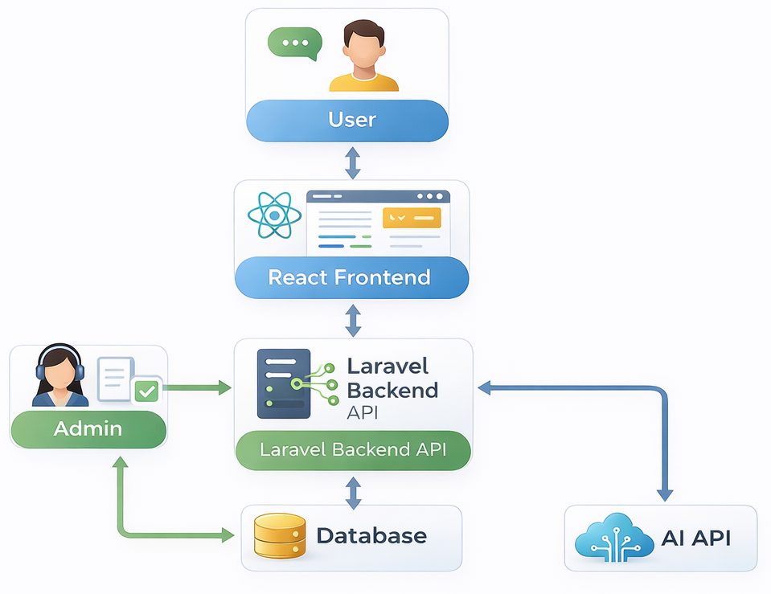

Slide 13
Live Demo & Code
5

Slide 14
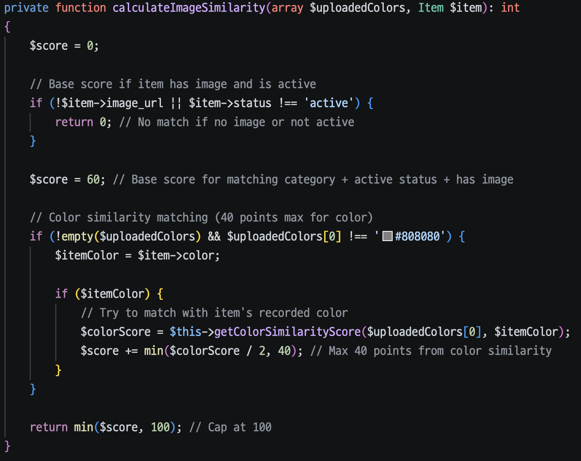
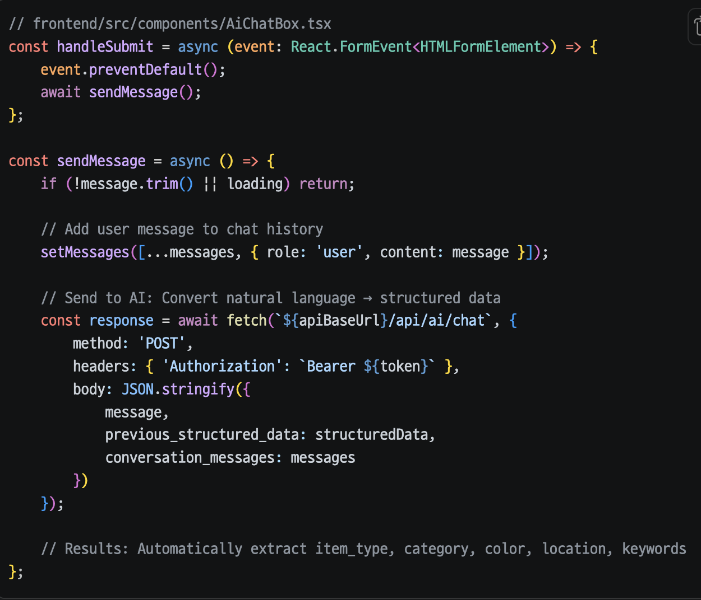
Code

Slide 15
Conclusion
6

Slide 16
A Smarter BCIT Campus
Transforming a stressful manual process into a seamless digital experience.
Future Scope
Campus-Wide Expansion : Rollout to Downtown, Aerospace, and Marine campuses.

Slide 17
THANKS!
Any questions?

